Slide 1
17
Financial Leverage and Capital Structure Policy

Slide 2

Chapter 17 – Index of Sample Problems
Slide # 02 - 03 Break-even EBIT
Slide # 04 - 11 Homemade leverage
Slide # 12 - 13 M&M Proposition I, no tax
Slide # 14 - 15 M&M Proposition II, no tax
Slide # 16 - 21 M&M Proposition I with tax
Slide # 22 - 27 M&M Proposition II with tax

Slide 3
2: Break-even EBIT
You are considering two different capital structures. The first option consists of 20,000 shares of stock. The second option consists of 10,000 shares of stock plus $200,000 of debt with an interest rate of 8%. Ignore taxes.
What is the break-even level of EBIT between these two options?

Slide 4
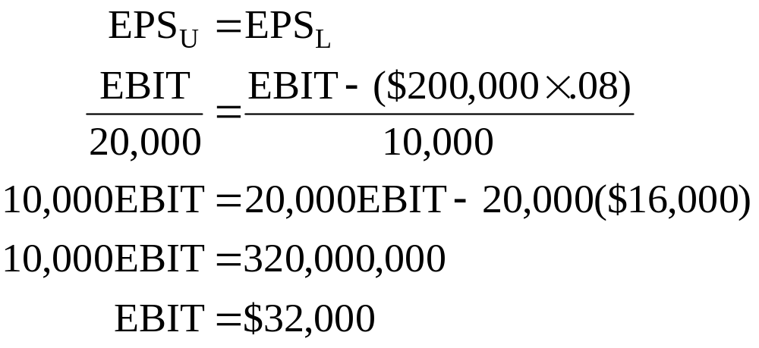
3: Break-even EBIT

Slide 5
4: Homemade leverage
ABCO, Inc. has EBIT of $100,000. There are 50,000 shares of stock outstanding at a market price of $20 a share. ABCO has just decided to issue $400,000 of debt at a rate of 8% to repurchase shares of stock. Fred owns 20,000 shares of ABCO stock. Fred wants to use homemade leverage to offset the leverage being assumed by ABCO.
How many shares of ABCO stock must Fred sell to achieve his goal if he loans out the funds from the stock sale at 8% interest?

Slide 6
5: Homemade leverage
No Debt Debt
EBIT $100,000 $100,000
Interest 0 ?
Net income $100,000 ?
# of shares 50,000 ?
EPS $2.00 ?

Slide 7
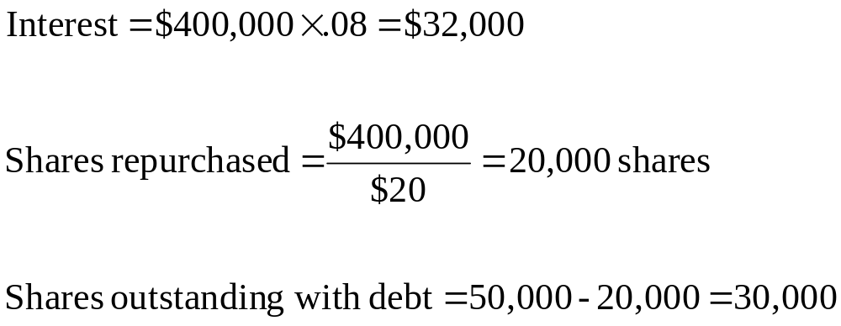
6: Homemade leverage

Slide 8
7: Homemade leverage
No Debt Debt
EBIT $100,000 $100,000
Interest 0 32,000
Net income $100,000 $ 68,000
# of shares 50,000 30,000
EPS $2.00 $2.2667

Slide 9
8: Homemade leverage
Unlevered:
20,000 shares × $2.00 = $40,000
Levered:
20,000 shares × $2.2667 = $45,334

Slide 10
9: Homemade leverage
Weights
Stock: 30,000 × $20 = $ 600,000 60%
Debt: = $ 400,000 40%
Total: $1,000,000 100%

Slide 11
10: Homemade leverage
Investment = 20,000 × $20 = $400,000
Stock:
60% of $400,000 = $240,000
$240,000 ÷ $20 = 12,000 shares
Loan out:
40% of $400,000 = $160,000

Slide 12
11: Homemade leverage
No company debt and no homemade leverage:
20,000 shares × $2.00 = $40,000
Homemade leverage used to offset firm leverage:
Stock: 12,000 × $2.2667 = $27,200
Loan: $400,000 × .08 = $12,800
Total: $40,000

Slide 13
12: M&M Proposition I, no tax
A debt-free firm currently has 400,000 shares of stock outstanding. The company is considering reducing the number of shares to 300,000. To do this, the firm will have to borrow $5 million at 8% interest.
Ignoring taxes, what is the value of the firm?

Slide 14
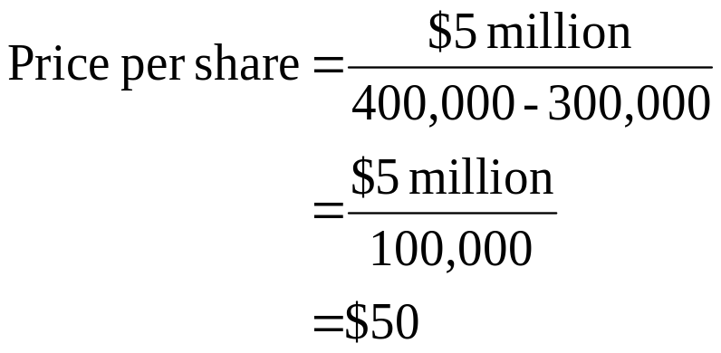
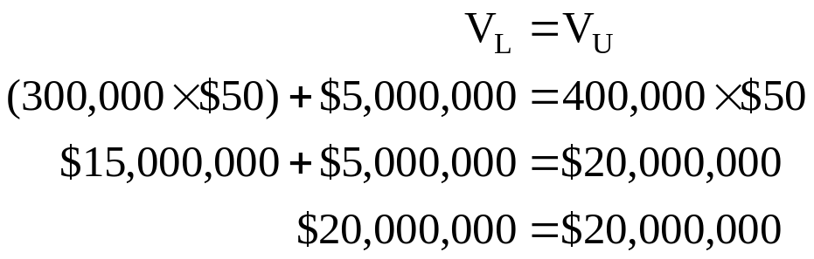
13: M&M Proposition I, no tax

Slide 15
14: M&M Proposition II, no tax
Walter’s Store has a debt/equity ratio of .60. The required return on assets is 12% and the pre-tax cost of debt is 8%. Ignore taxes.
What is the cost of equity?

Slide 16

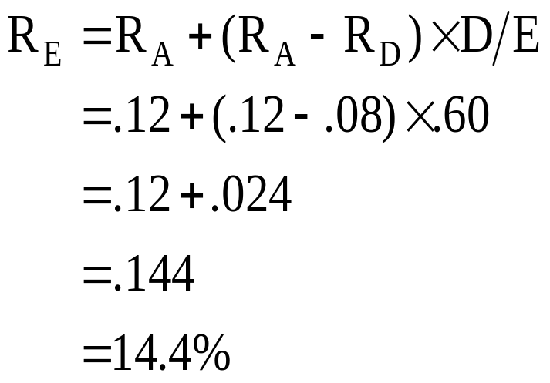
15: M&M Proposition II, no tax

Slide 17
16: M&M Proposition I with tax
The Bigely Co. has $5,000 worth of debt outstanding that is selling at par. The coupon rate is 9% and the company tax rate is 34%.
What is the amount of the annual tax shield?
What is the present value of the tax shield?

Slide 18
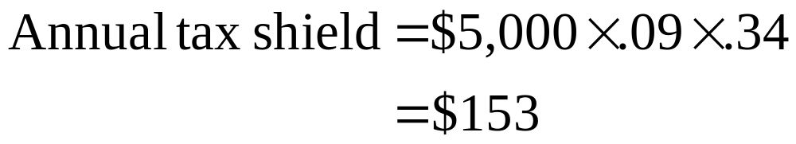
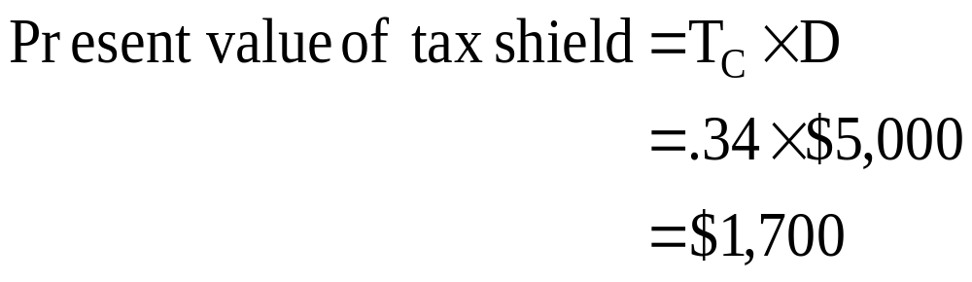
17: M&M Proposition I with tax

Slide 19
18: M&M Proposition I with tax
Dawn, Inc. has 150,000 shares of stock outstanding at a market price of $30 a share. The cost of equity is 10%. The company is considering adding $1.5 million of debt with a coupon rate of 7%. The debt will sell at par. The tax rate is 35%.
What will the value of Dawn, Inc. be after they add the debt to their capital structure?
What is the levered value of the equity?

Slide 20
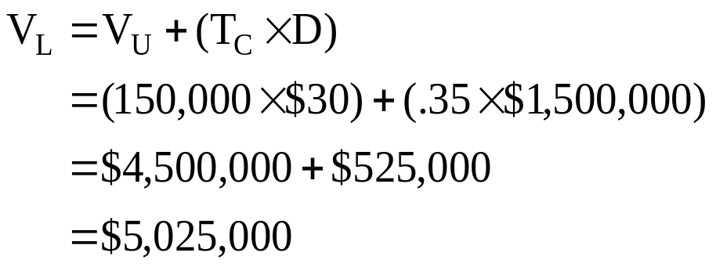
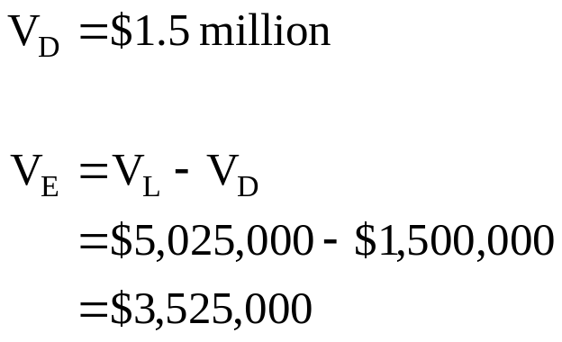
19: M&M Proposition I with tax

Slide 21
20: M&M Proposition I with tax
The Baker Co. has an unlevered cost of capital of 12% and a tax rate of 35%. The expected EBIT is $1,200. The company has $3,000 of debt which is selling at par. The coupon rate is 8%.
What is the value of the firm?

Slide 22
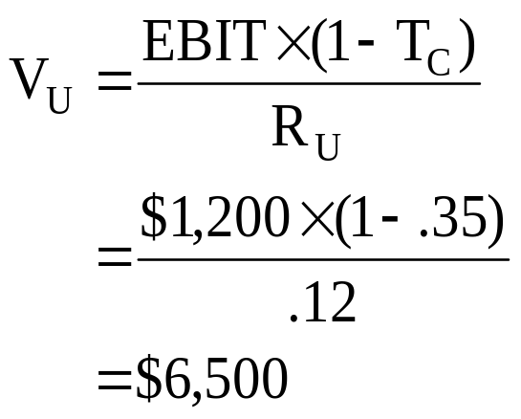
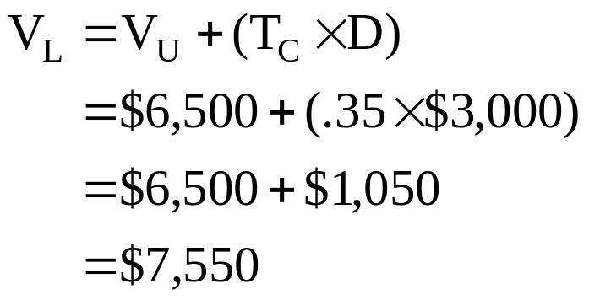
21: M&M Proposition I with tax

Slide 23
22: M&M Proposition II with tax
Charlie & Co. has $2,500 in bonds outstanding that are selling at par. The bonds have a 7% coupon rate and pay interest annually. The expected EBIT is $1,400 and the unlevered cost of capital is 10%. The tax rate is 35%.
What is the cost of equity?

Slide 24
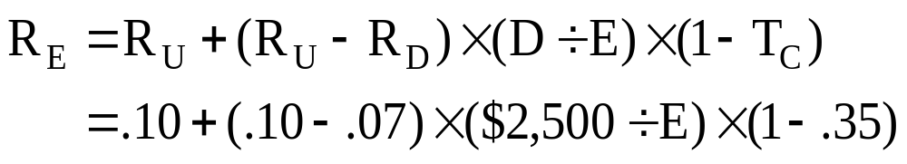
23: M&M Proposition II with tax

Slide 25
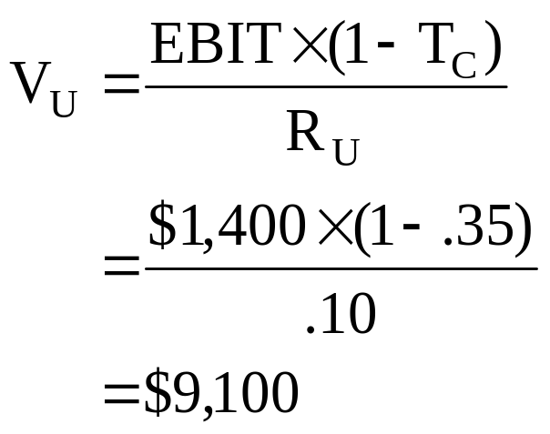
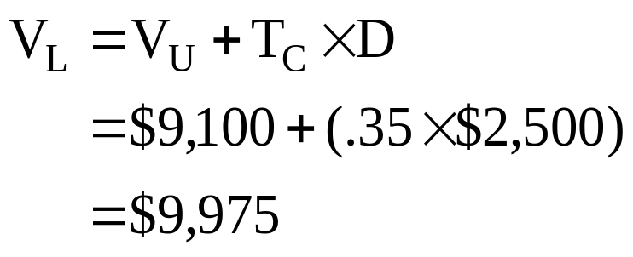
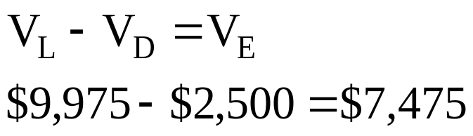
24: M&M Proposition II with tax

Slide 26
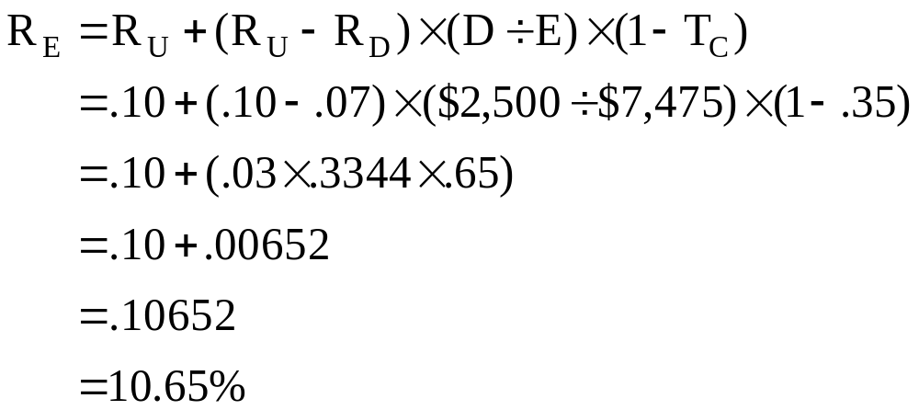
25: M&M Proposition II with tax

Slide 27
26: M&M Proposition II with tax
Using the information from the last problem, you have debt of $2,500, equity of $7,475, V_{L} of $9,975, R_{D} of 7%, R_{E} of 10.65% and a tax rate of 35%.
What is the weighted average cost of capital (WACC)?

Slide 28
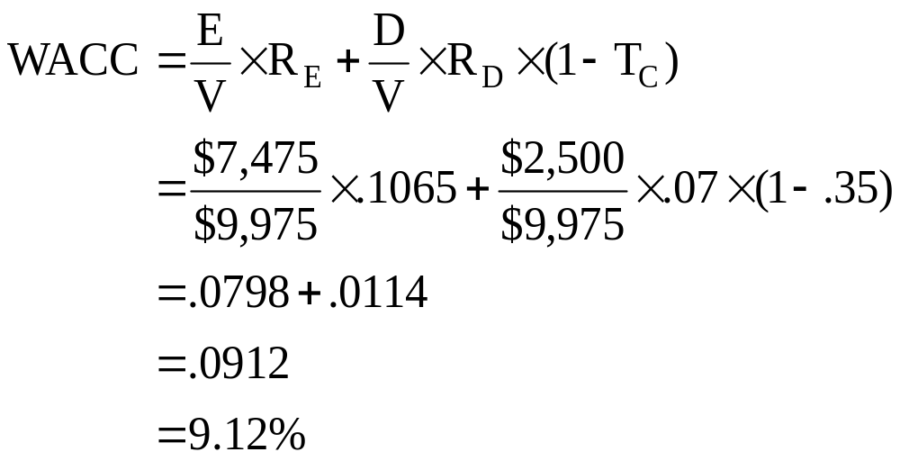
27: M&M Proposition II with tax

Slide 29
17
End of Chapter 17

